Slide 1
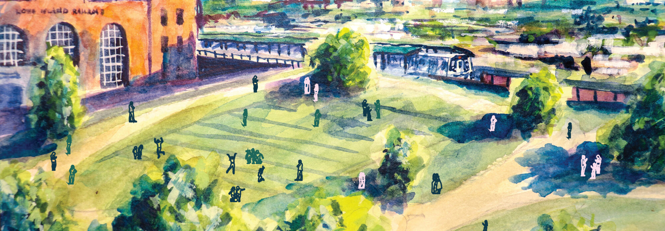
The QueensLink Project
January 14th, 2025
Jan Mendez
Elliot Jackson-Ontkush
Wesley Nay

Slide 2
Agenda
History and Background
Other Alternative Proposals
External Request and Research Question
Defining the QueensLink Project Area
Socio-Economic and Mobility Indicators
Use and Applications
Next Steps

Slide 3
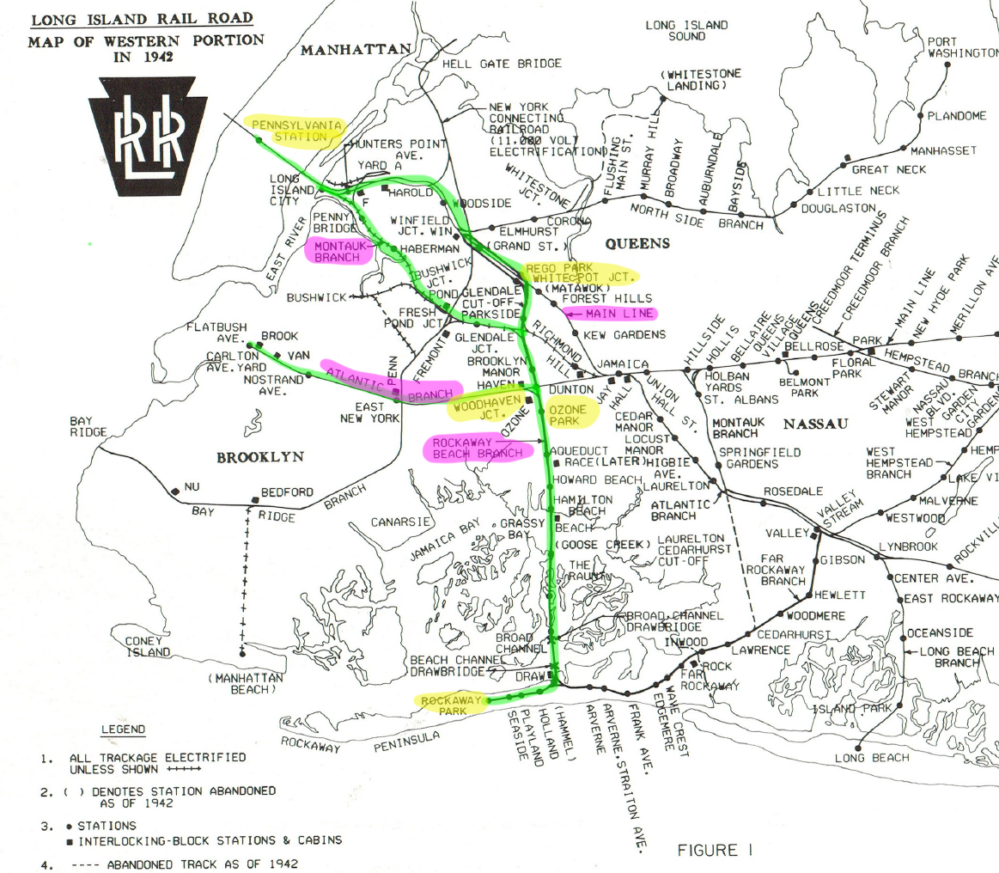
History and Background
1880: The Rockaway Beach Branch opens as the New York, Woodhaven, and Rockaway Railroad
1887: Bankruptcy and acquired by the Long Island Rail Road (LIRR)
1910: LIRR completely rebuilds Main Line from Penn Station to Jamaica.
1939 – 1942: LIRR Atlantic Branch is put into a subway, and Rockaway Branch uses this tunnel to reach Downtown Brooklyn.
1950: Fire on the Rockaway Beach Branch leads to cut in all service south of Ozone Park.
1952: The City of New York sees potential in the line and buys it.
1962: All service cut. Line has been abandoned for 62 years.
Notes:
Ran along the LIRR Montauk Division to Glendale. From Glendale, it branched off and ran south through Woodhaven, across Jamaica Bay on a wooden trestle, and to Rockaway Beach. One year later, the line was connected to the LIRR Atlantic Branch, with direct service to Downtown Brooklyn. But since it wasn't part of LIRR but used LIRR tracks, it lost revenue to the LIRR, leading to bankruptcy in 1887. Bankruptcy forced the line's sale to Austin Corbin of the LIRR, who reorganized it as the New York and Rockaway Beach Railway and leased it to his own LIRR

Slide 4
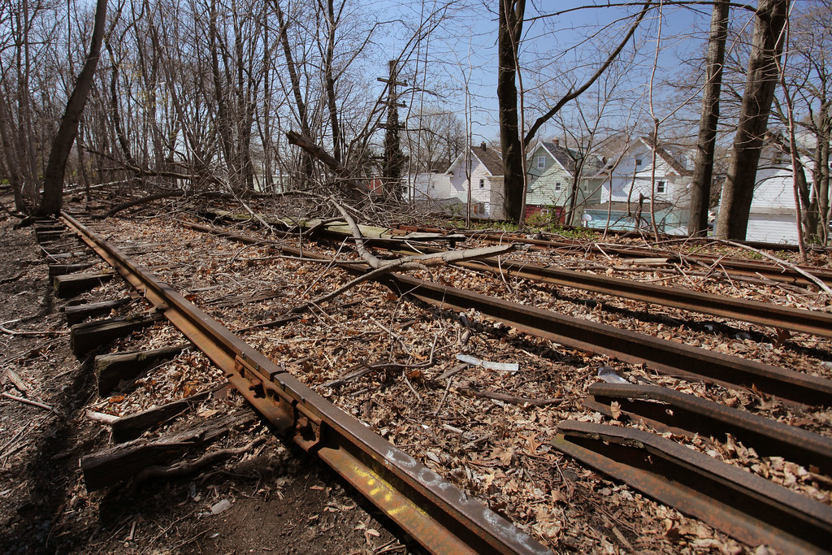
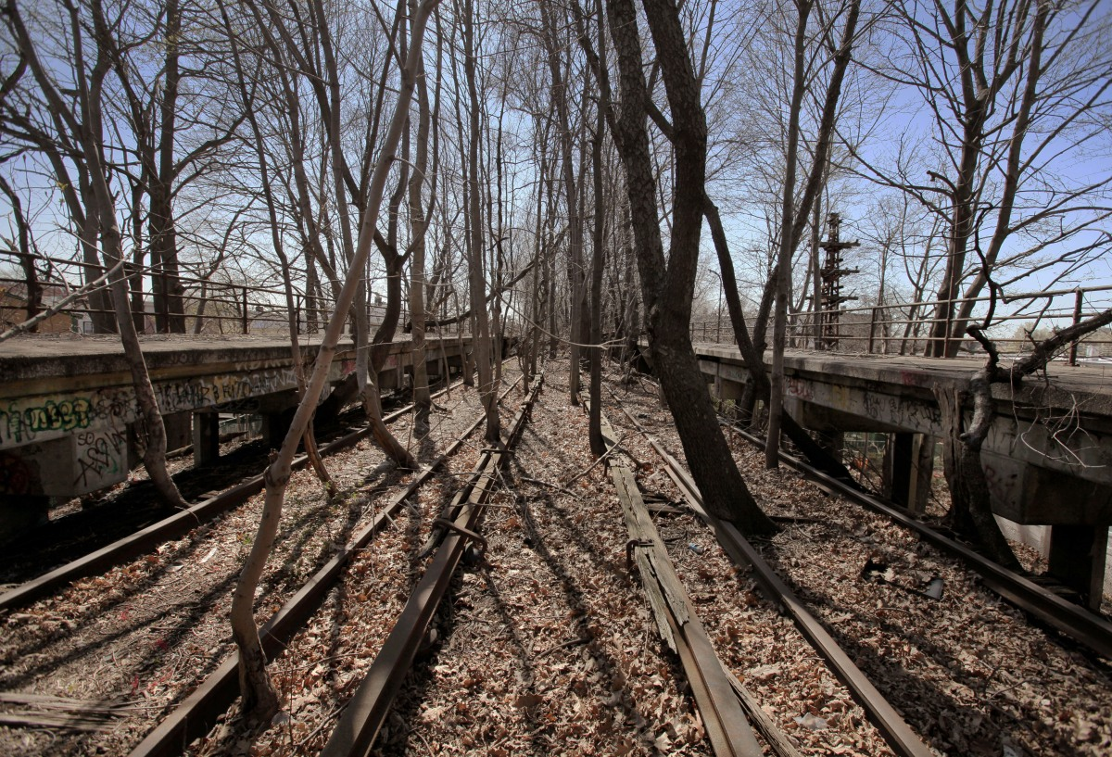
Currently Abandoned Infrastructure

Slide 5
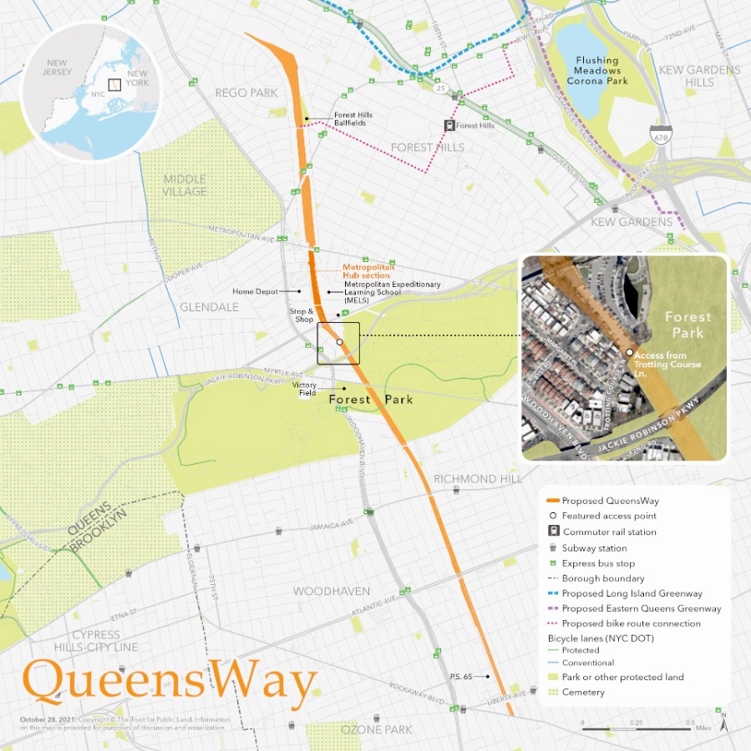
Proposed Alternative: QueensWay
Seeks to convert the land into a new highline style park stretching 47 acres with 7 miles of greenway
No public transit component
Seemingly favored by Eric Adams, who announced $35 million investment in September 2022 for Phase 1
NYC Parks and Trust for Public Land awarded a $117 million federal grant in March 2024 for Phase 2

Slide 6
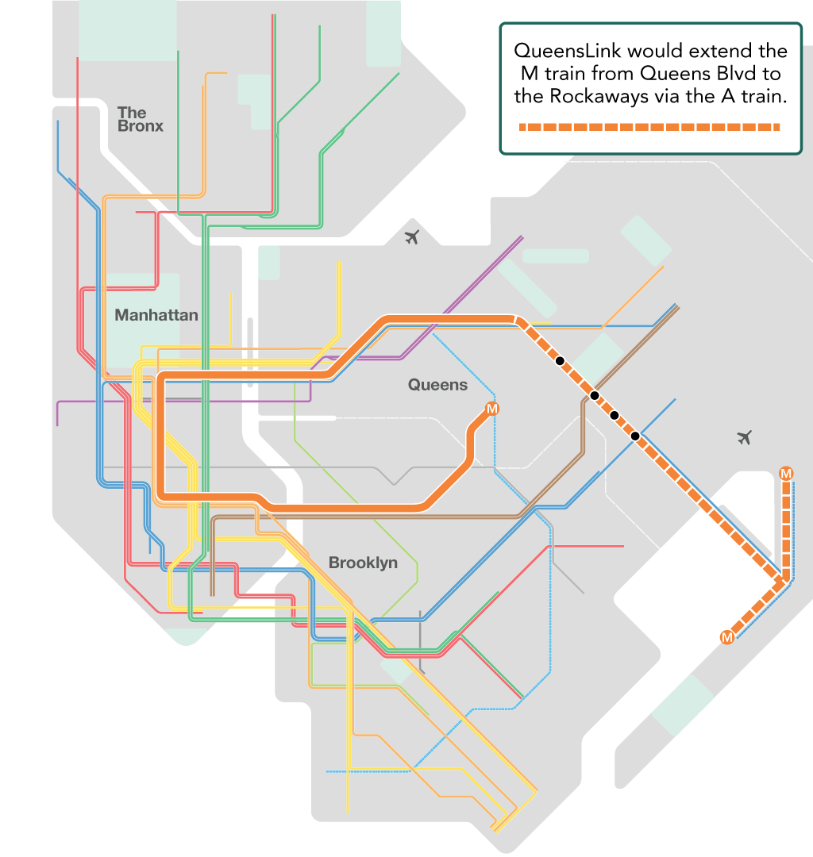
Proposed Alternative: QueensLink
Seeks to connect the Queens Blvd line to the Rockaways via the A train to create the first North-South Borough line
Includes 4 new stations with transfers to the A, J/Z, EFR, and LIRR trains
Proposes up to 33 acres of new parks and protected bike paths along the right-of-way
MTA 2019 feasibility study
TEMS feasibility study June 2021
Similar project:
  Southwest Corridor in Boston, MA
Notes:
MTA feasibility study: cost estimate of between $6 and $8 billion (official cost estimate 8.1 billion)
TEMS (Transportation Economics and Management Systems Inc.): $3.4-$3.7 billion
The official cost estimate of $8.1 billion was inflated using non-standard contingency and Year of Expenditure Escalation calculations (based on FTA guidelines) and higher Professional Service fees

Slide 7
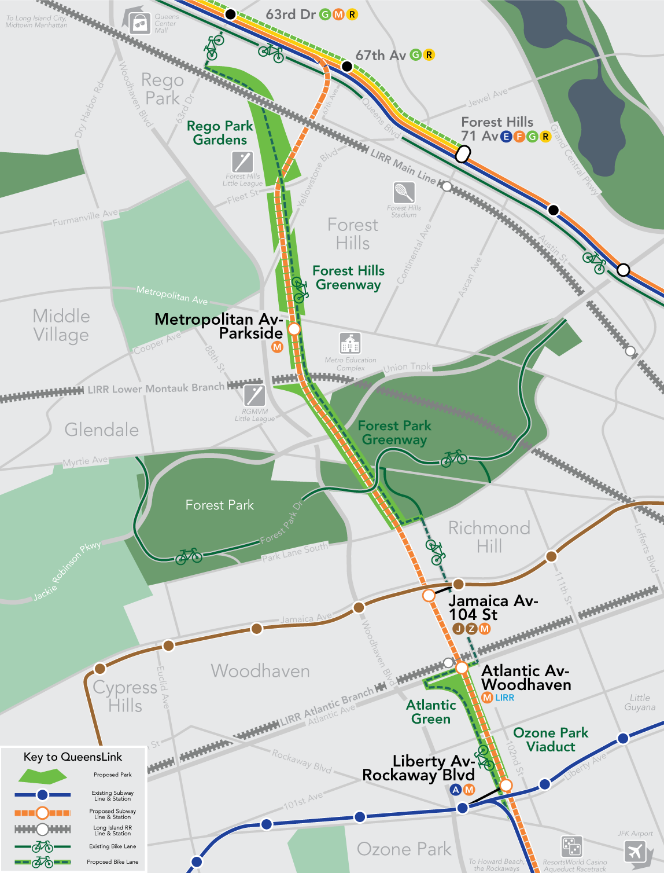
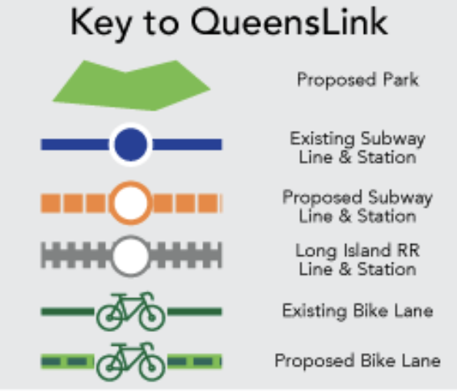
QueensLink cont.
Would extend the M train from Forest Hills-71st Ave
Support for QueensLink
  Council member Selvena Brooks-Powers
State Senator conducted constituent survey: 75% in support of QueensLink
Jan 10, 2025: US DOT announces $400,000 grant for QueensLink
Notes:
Instead of ending at the 71st/Continental stop in Forest Hills, the M line would branch off from the other Queens Boulevard subway lines between the 63rd Drive and 67th Avenue stations (dashed orange line). It would run south in a new tunnel under 67th Avenue until Fleet Street, where it would turn slightly to run below the former LIRR Rockaway Beach Branch right-of-way.

Slide 8
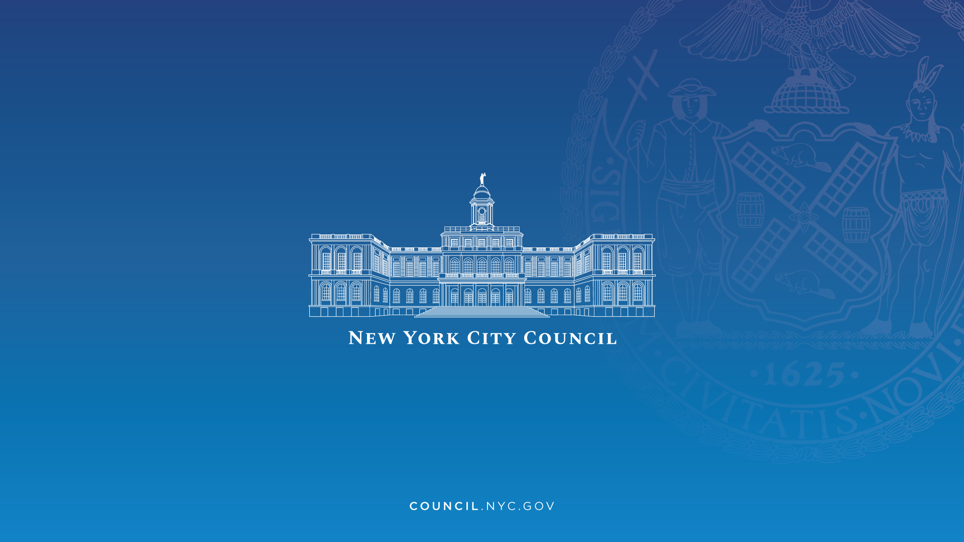
External Request
Council Member Selvena Brooks-Power
Res. 0059-2024 - Economic impact of the QueensLink project.
New transit alternatives for residents and invest in the local economy.

Slide 9
Research Questions
How do socio-economic indicators relate to transit accessibility?
02
What characteristics can best speak to transit access in New York City?
04
What is the history of the north-south rail line in East Queens? (context)
01
How do the means of transportation relate to transit accessibility?
03
How can the QueensLink project impact the neighborhoods around it?
05
Notes:
This is a relatively new project for the IBO, therefore, we wanted to make sure we covered all of the areas that this request encompasses:

Slide 10
ArcGIS Story Map
QueensLink Evaluation

Slide 11
Data Sources
New York City Department of City Planning
New York City Department of Buildings
United States Census Bureau

Slide 12
Next Steps
Audience
Format
Applications for future projects

